Slide 1
8254 Programmable Interval Timer
The topic is well covered in the textbook DV Hall

Slide 2
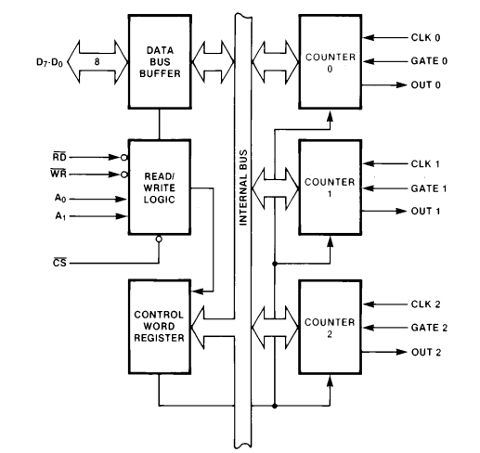
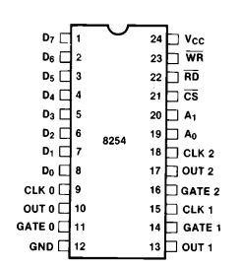
Block Diagram

Slide 3
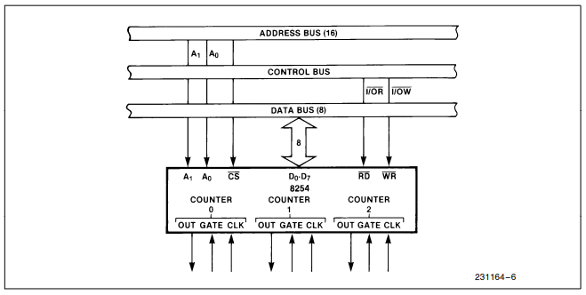
System interface

Slide 4
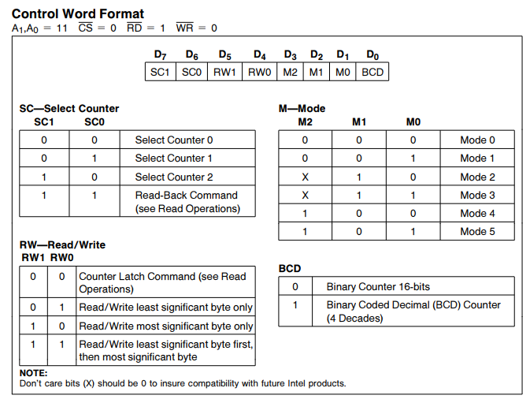
Control Word Format
The Control Words are written into the Control Word Register, which is selected when A1,A0= 11.
The Control Word itself specifies which Counter is being programmed.

Slide 5
Example
MOV AL,00010111B ;00 means Counter 0,
;01 means read/write LSB,
;011 means Mode 3,
;1 means BCD
MOV DX,0FF07H ; FF07H is the address of CWR
OUT DX,AL ; Send the command word to CWR
MOV AL,32H ; Assuming 32H as LSB of count
MOV DX,0FF01H ; Point to Counter 0 count register
OUT DX,AL ; Send count to count register

Slide 6
Features of 8254
Reads and writes of the same Counter may be interleaved;
For example, if the Counter is programmed for two byte counts, the following sequence is valid.
Read least significant byte.
Write new least significant byte.
Read most significant byte.
Write new most significant byte.

Slide 7
Write Operation
The programming procedure for the 8254 is very flexible.
Only two conventions need to be remembered:
For each Counter, the Control Word must be written before the initial count is written.
The initial count must follow the count format specified in the Control Word (least significant byte only, most significant byte only, or least significant byte and then most significant byte).

Slide 8
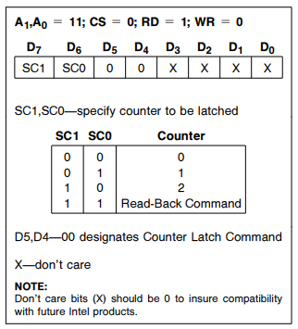
Read Operation
There are three possible methods for reading the counters:
Simple read operation,
Counter Latch Command,
Read-Back Command.
Counter Latch Command:
Like a Control Word, this command is written to the Control Word Register, which is selected when A1,A0=11. Also like a Control Word, the SC0, SC1 bits select one of the three Counters, but two other bits, D5 and D4, distinguish this command from a Control Word.
The selected Counter’s output latch (OL) latches the count at the time the Counter Latch Command is received. This count is held in the latch until it is read by the CPU (or until the Counter is reprogrammed). The count is then unlatched automatically and the OL returns to ‘‘following’’ the counting element (CE). This allows reading the contents of the Counters ‘‘on the fly’’ without affecting counting in progress.
Counter Latching Command Format

